Slide 1
The World of Self Publishing
Removing the stain and stigma
www.msauret.com

Slide 2
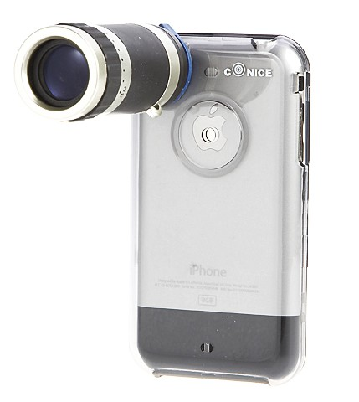
Before we begin…
One of you will win an autographed copy of “Amidst Traffic” tonight!
              Whip out your smart phone
              “Like” Amidst Traffic on Facebook
              Take a photo of me doing this workshop
              Post the photo on Amidst Traffic’s wall & post yourself
              Best photo wins a book

Slide 3
Perception…
When you hear the word “Self Published” what thoughts come to mind?

Slide 4

Who am I?
Michel Sauret
-2008 Army Journalist of the Year
-Won several Army journalism awards
-Short stories published internationally, including in the “Best New Writing” anthology, released annually by the Eric Hoffer Award
-Indie Author of “Amidst Traffic” and “Breathing God”
www.msauret.com

Slide 5


Self publishing has come a long way
2005 2012
VS
Published with Publish America Self-Published
$24.95 Paperback $12.95 Paperback
No Kindle Edition $2.99 on Kindle

Slide 6
You have three options.
You can be either:
Crazy
Stupid
or
Adventurous

Slide 7
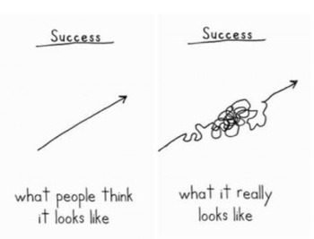
Success…

Slide 8
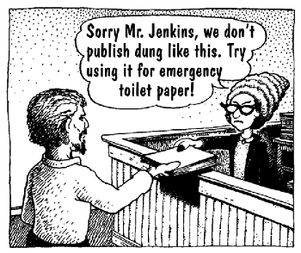
First… the bad news.

Slide 9
A look at the stats
The publishing world is already overcrowded. Adding your book to the mix, won’t solve the problem.
2005: 300+ thousand books published
2009: 1 million books published
2010: 3 million books published
2012: 15 million estimated ISBNs issued
Two thirds of these are self-published
Source: www.outthinkgroup.com / Bowker
The sales odds are against you:
  The average (traditionally) published author sells about 2,500 paperback copies.
  The average indie author sells 250
  Source: www.MichaelHyatt.com
People won’t care (at first):
  “So you’re self-published, huh? That’s nice…”

Slide 10
Sales statistics don’t stack up
Sales growth are not in line with publication numbers growth
  The number of books published are doubling or even tripling each year
  And yet, book sales are growing by only 10% to 20% each year (Source: www.fonerbooks.com)

Slide 11
Odds (and the Force) are against you
Average number of book sales are dropping per book due to the explosion of books being published
A book has less than a 1% chance of being stocked in a bookstore!
Barnes & Noble won’t even touch your book unless you’re stocked in their warehouse; that means no book events or book signings in store!
  In 2005, I was able to secure book signing events with two different book stores just by walking in and talking with a manager (Borders & Waldenbooks). That’s impossible to do now.
  You’ll have to be more creative than ever to set up book signing events nowadays!

Slide 12
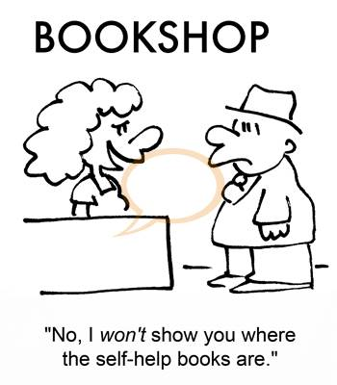
Don’t expect to get stocked

Slide 13

Expect to spend money
Professional editing: $1,500 to $3,000
Book cover: $250 to $1,000
Book layout & formatting: $150 to $350
Book listing: $25 to $300
Book printing: $5 to $10 per book
Total: $1,925 to $4,650 before printing a single book
We haven’t spent a single dollar on advertising yet!

Slide 14
You’re on your own
Being an Indie Author means flying solo:
  no coach, no mentor, no publicist, no editor and no sanity check to keep you motivated once your book is launched
  Prepare to do a LOT of work to market and promote your book
You have to be in it for the long haul.
  Overnight successes are the exception, not the rule
  New York Literary Agent Noah Lukeman tells authors to write and promote for 20 YEARS before they can expect to see real success (with multiple books)

Slide 15
The stigma still stings
Despite all of your hard work and credentials, most news organizations won’t even touch your book for review due to the stigma that self-publishing still holds
“Don’t self-publish. That’s as good as admitting you’re too lazy to do the hard work,” Sue Grafton, author of the A-Z thriller series.
Without an established publisher, your book will lack initial legitimacy to attract public attention. You will have to earn EVERY reader.

Slide 16
You might as well give up now, while you’re ahead…
There will be dark days of no sales and a sense of no hope. There will moments where you will feel you’ve wasted your time and the money you’ve invested in promoting your book. You will start to believe that maybe you really weren’t good enough to get published by a real publishing house. There will be days you will believe you are a loser and your book is not worth pursuing.
All of that is true. If you believe it.

Slide 17
And now for some hope
Self-publishing successes DO happen!
  John Locke was the first self-published author to sell a million copies of his book series on Amazon
  Hugh Howey, author of WOOL became a #1 Bestseller on Amazon and was picked up by Simon & Schuster for paperback distribution
  Darcie Chan, author of “The Mill River Recluse” sold 600,000 Kindle edition copies

Slide 18
A good year for Indies
2012 was a good year for Indie Authors
More and more websites now exist to promote, encourage and award indie authors – Even Kirkus (one of the largest book reviewers giants in the publishing industry) has a section solely devoted to indie writers
There are at least a dozen book competitions designed specifically for small-press and self-published titles, while a few years ago they might never be considered.

Slide 19
More options than ever
  Assisted self-publishing options have exploded
    Just a decade ago, most companies that provided self-publishing options were scams!
    Some scam companies still exist, but there are plenty legit options out there
  Assisted self-publishing companies provide an array of services, from editing to registration, book design and marketing.
    Pay-as-you go options
    Much more affordable than ever before

Slide 20
Costs have dropped
  Cost of print-on-demand options have dropped drastically
    From $10+ per book to $4.90 without having to buy in bulk!
  E-books have facilitated distribution
  What used to costs thousands of dollars, can now be accomplished with a few hundred

Slide 21
Quality has improved
  Self-published books used to mean
  cheap production at high cost
  Now it can mean high quality product at lower cost
  People who get their hands on Amidst Traffic are immediately impressed by the high quality of the book’s production

Slide 22
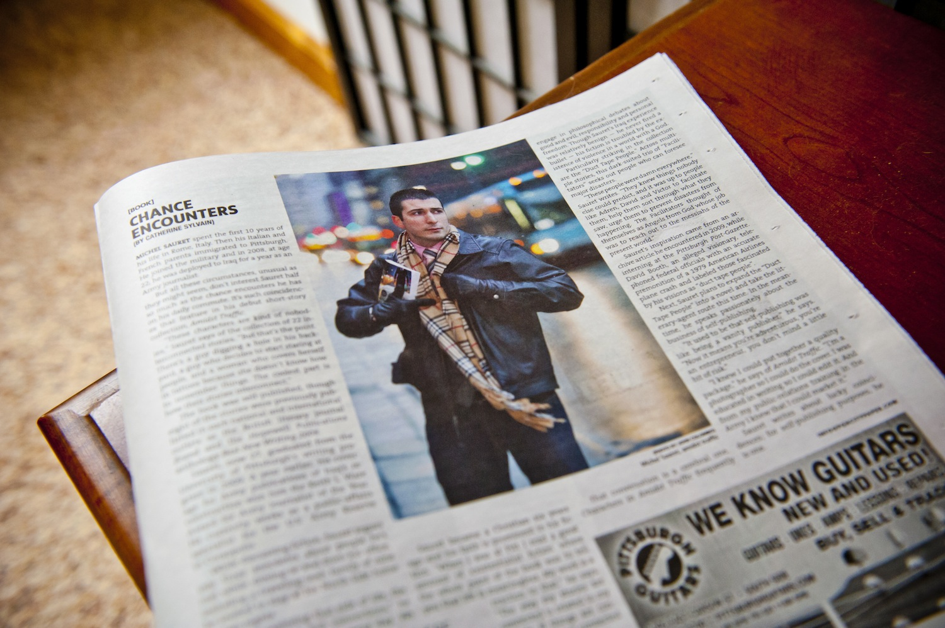
Some media is jumping on board

Slide 23
Some media is jumping on board
  Mainstream Media is finally taking notice
    NY Times recently broke policy by reviewing a self-published book in their newspaper
    Forbes, USA Today, the Wall Street Journal and The Huffington Post regularly report on the self-published industry
    Publishers Weekly has a magazine edition completely devoted to self-published authors (PW Select)

Slide 24
More access to knowledge
  Even without an editor or agent, the answers are out there with plenty of websites devoted fully to indie authors
  Social media is your friend
    With the resources available today, you can promote your book effectively by investing less money than ever before
    (Just know that all the other authors will be doing the same thing)

Slide 25
Quality resources
  Indie Reader
    www.indiereader.com
  Independent Publisher
    www.independentpublisher.com
  Blogging Authors
    www.bloggingauthors.com
  The Creative Penn
    www.thecreativepenn.com

Slide 26
Let’s get started…
  Project your publication date 6-9 months out after your book is complete and polished
  The self-publishing playing field used to be filled with scams and other dangerous/expensive land mines
  There are areas where you shouldn’t go cheap and other areas where with some DIY effort you can save yourself some money

Slide 27
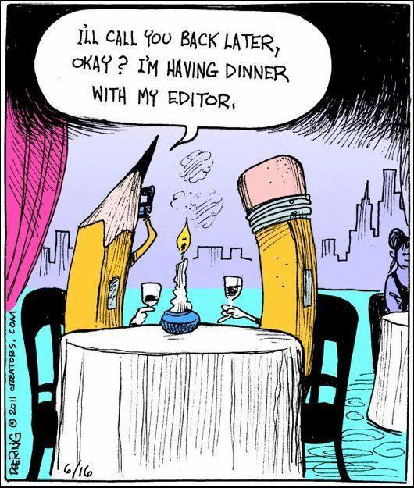

Slide 28
Edit… before you publish
  Edit, revise, re-read and have others read
  When I was getting ready to publish Amidst Traffic, I read and corrected the “final” manuscript at least 15 times, and I still missed dozens of mistakes
  “Chicago Manual of Style” is the editing book standard for most book publications
  Spend the money: Hire an editor.
    Prove the skeptics wrong, produce a professional product
    Prices can range from $500 to $3,000+
    Prices vary based on word count, editing needs and editor’s experience

Slide 29
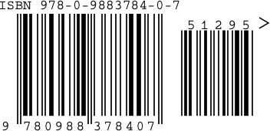
Register for an ISBN
  Bowker is the sole distributor of ISBNs in the U.S.
    Some self-publishing companies offer to provide your book an ISBN for free
    You’re better off registering your own
  www.myidentifiers.com
    $125.00 for 1 ISBN
    $250.00 for 10 ISBN
  Each edition must have its own ISBN
  Free ISBN barcode from www.adazing.com

Slide 30

The Cover

Slide 31
The Cover
Don’t go cheap here…
75% of 300 booksellers surveyed said the look and design of the book cover is the most important component of choosing what to sell. (Source: www.selfpublishingresources.com)
The book cover is like a business card or a hand-shake. It tells you almost nothing about the actual quality of the book’s interior, but if it’s bad, readers won’t even give it a chance.

Slide 32
Cover design options
  CreateSpace.com
    Options from $149.00 to $749.00
  Lulu.com
    From $130.00 to $450.00
  Adazing.com
    $450.00 for multiple cover options
  Find a college student in graphic design
  Post a listing on Craigslist

Slide 33
E-book publishing options
  Kindle
    http://kdp.amazon.com
  Nook
    http://pubit.barnesandnoble.com
  iBook
    http://www.apple.com/itunes/content-providers/
  Google Books
    http://books.google.com

Slide 34
E-book publishing options
  Some companies charge $250+ to format and publish your book to all providers
  With some time and effort you can accomplish the same thing for free
  Most of the time, you can format your e-book using just Microsoft Word
  Start with Kindle and expand from there
  Each provider offers different promotional options, from discount codes to free promo days
  Royalty rates vary
  List your book between $.99 and $2.99

Slide 35
Print publishing options
  Create Space
    www.CreateSpace.com
  Lulu
    www.lulu.com
  iUniverse
    www.iUniverse.com
  Trafford
    www.trafford.com
  Author House
    www.authorhouse.com
  Xlibris
    www.xlibris.com

Slide 36

  Company is owned by Amazon.com
  You can publish your book here for as little as nothing if you do most of the work yourself
  The company makes money by distributing your book through Amazon.com
  Author retains all copyrights
  Printing books is very affordable ($5.05 for a 350-page book) & no minimum book purchase is required
  Wide variety in paperback sizes
  No hard-cover options
  Track sales on author dashboard
  Really good quality printing

Slide 37

  Low-commitment and no-pressure publishing
  Free ISBN provided
  Good quality printing
  Automatically lists your book on Barnes & Noble’s website
  Can print both paperback and hardcover but size options are limited
  Print cost depend on purchase quantity
    $13.90 for 350-page paperback (1 copy)
    $20.65 for 350-page hardcover (1 copy)
  Very user-friendly website

Slide 38

  Supported self-publishing
  Packages range from $899 to $4,599
  Publishing process is assisted, but you can also expect pressure sales tactics
  “Free” copies offered with packages
  Allows book sellers to return books ($749 add-on)
  Prints both softcover and hardcover
  No up-front listing of book printing cost for authors

Slide 39

  Supported self-publishing
  Packages range from $649 to $10,999 (offers seasonal specials)
  High-pressure sales tactics
  Has been reported to not pay authors royalties
  “Free” copies offered with packages
  Prints both softcover and hardcover
  Limited re-edit updates
  No up-front listing of book printing cost for authors

Slide 40
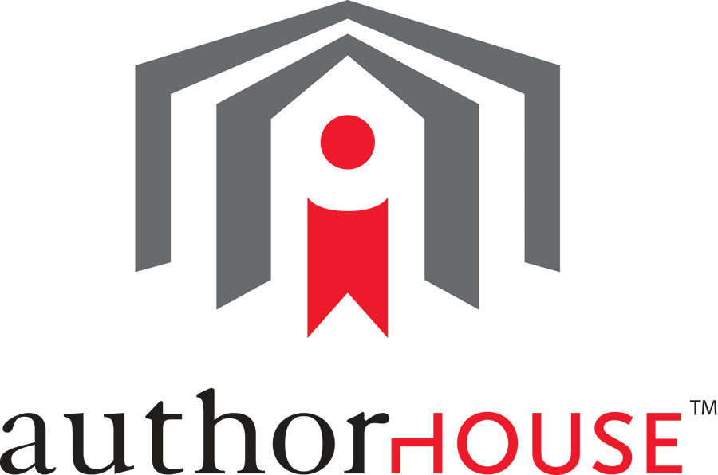
  Supported self-publishing
  Packages from $749 to $4,249
  Book printing prices are insanely high!
    $23.95 for a 350-page book
    Forces you to sell books for $25.00 per book
  Overall printing options are limited

Slide 41

  Assisted self-publishing
  Packages range from $499 to $15,249
  Printing cost is $11.19 per book unless you buy 10+ copies (From $6.40 to $10.39 per copy)
  Provides a wide variety of services

Slide 42
The book is published, now what?
  Now the real work begins.
  You’ll spend three times as much times agonizing over promoting, marketing and selling your book than you did writing it!
  Nonstop hustle, often with little initial reward
  If you don’t have it in you to promote your book, don’t venture into self-publishing

Slide 43
Submit your book for reviews
  Backward plan! Plan to send out your book for review 3-4 months before your publication date
  This will consist of the bulk of your “marketing” expense
  Submit your book to reputable, objective review companies
  There are ways of submitting your book for consideration for a free review, but it’s not guaranteed you’ll get one
  Expect to give away 20-30 paperback copies for review
    $100-$150 in book cost alone

Slide 44
Free book review options
  Reader Views
    www.readerviews.com
  Midwest Book Review
    www.midwestbookreview.com
  Library Journal
    http://reviews.libraryjournal.com
    Must submit 3-4 months from pub date
  ForeWord pre-publication reviews
    www.forewordreviews.com

Slide 45
Free book review options
  Readers’ Favorite
    www.readersfavorite.com
  Portland Book Review
    www.portlandbookreview.com
  San Francisco Book Review
    www.sanfranciscobookreview.com
  Indie Reader
    www.indiereader.com/author-promotional-opportunities
  Biblio Buffet
    www.bibliobuffet.com

Slide 46
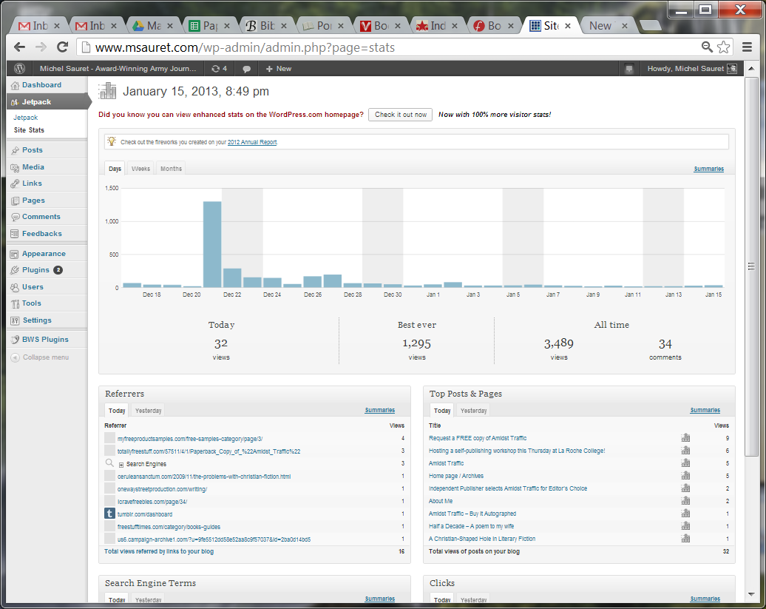
Giving away books for free attracts attention

Slide 47
Guaranteed (paid) reviews
  Kirkus Reviews (indie)
    $425-$575
  Blue Ink Review
    $395-$495
  Clarion Review
    $335-$549
  ForeWord Review
    $129
  Reader Views
    $119 & additional marketing options

Slide 48
Guaranteed (paid) reviews
  Portland Book Review
    $125-$450
  San Francisco Book Review
    $125-$299
  IR Discovery Awards
    $150 - Hosted by Indie Reader
    Review plus submitted for award competition

Slide 49
Launch a quality website
  Should have a clean design
  Visually appealing
  Reflect your personality
  Easy to navigate
  Double it as a blog
  www.themeforest.net is a great resource for affordable design templates

Slide 50
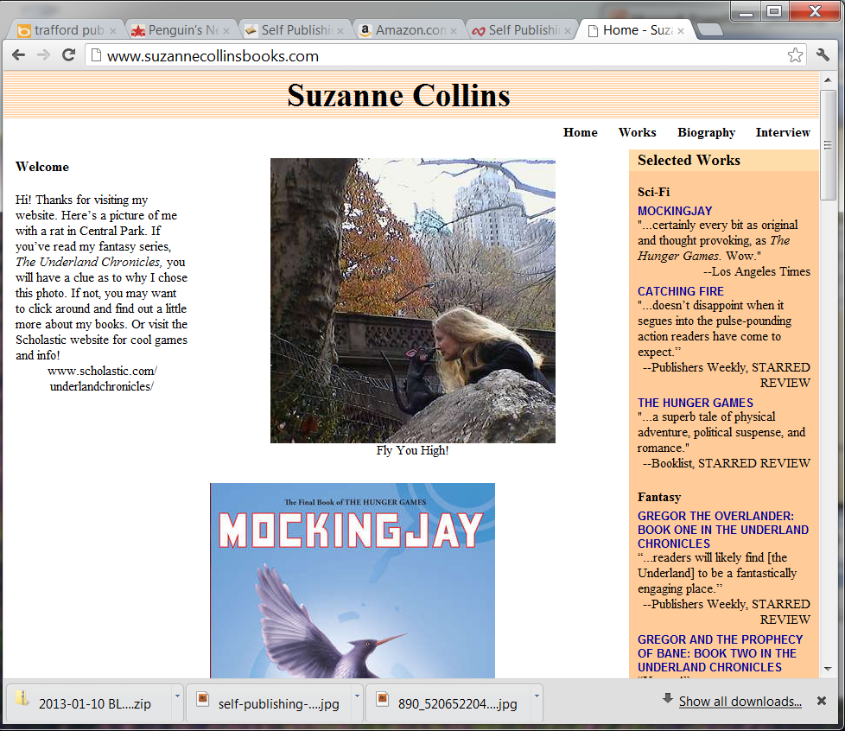
And now for some hope

Slide 51
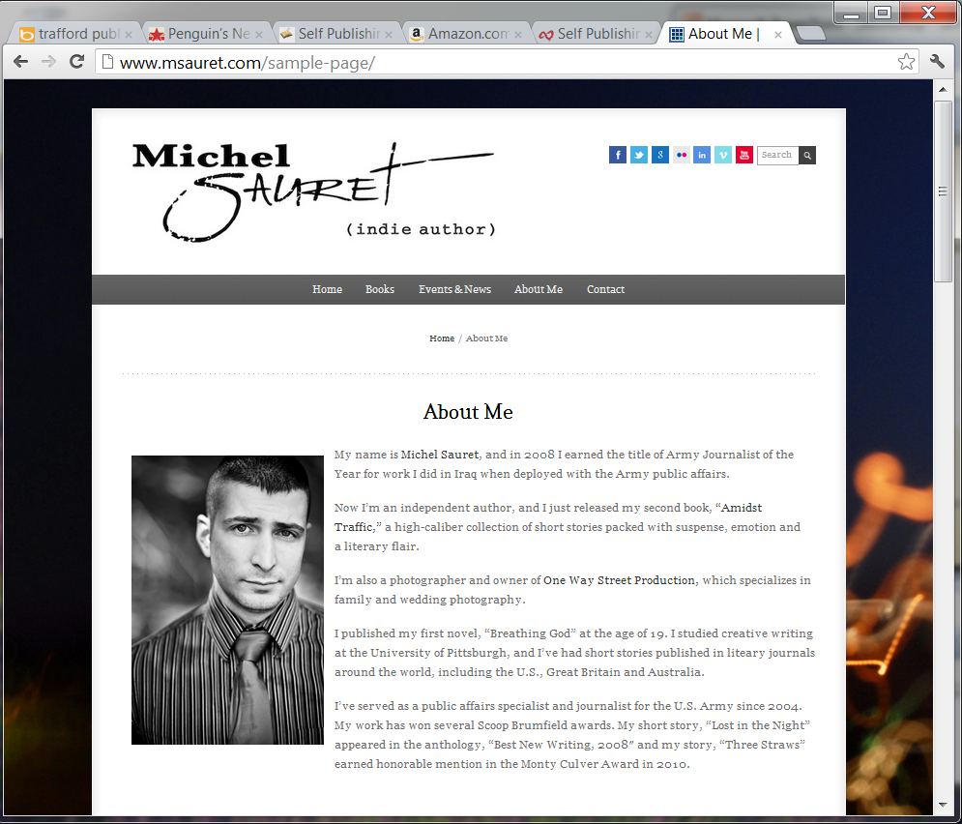
And now for some hope

Slide 52



Social media beyond F & T

Slide 53

Reach out to news media
  Create & maintain a distribution list
  Learn to write professional press releases (AP Style Book)
  Send out releases for upcoming events
  MailChimp is a great resource for sending out newsletters, press releases and campaigns

Slide 54


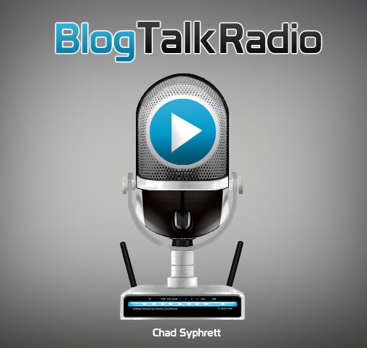
Snag some radio
& podcast interviews

Slide 55
Submit book for awards
  Most thorough list of book awards dedicated to indie and self-published authors
  www.thebookdesigner.com/book-awards/
  Each competition can cost anywhere from
  $50-$150 per submission
  Find awards that list your specific category

Slide 56
Create a support system
  Finding people who believe in you and can support you
  Start connecting now with writing professors, authors, editors, bloggers… anyone who can help propel you forward in the future
  People who fail, blame others.
  People who succeed thank others.

Slide 57
Questions?

